Slide 1
EQUITY MARKET SENTIMENT ANALYSIS USING NLP TECHNIQUES
ARUNA. S(211420205021) Mrs. REKHA
HARINI .T(211420205057) (ASSOCIATE PROFESSOR)
LAVANYA. K(211420205080)

Slide 2
Abstract
Equity market sentiment analysis plays a crucial role in financial decision-making, as investor sentiment often affects market trends and stock prices.
Everyday news on the economic front plays a vital role in defining the jump or drop in the prices of stocks.
This abstract presents a study on utilizing Natural Language Processing(NLP) techniques for equity market sentiment analysis.
The objective of this research is to develop a robust framework that leverages NLP techniques to analyse and predict equity market sentiment based on textual data from various sources, including financial news articles, social media posts, and investor forums.
The proposed framework consists of several stages, including data collection, pre-processing, feature extraction, sentiment analysis, and prediction.

Slide 3
OBJECTIVE & SCOPE
Objective:
Utilize Natural Language Processing (NLP) techniques to analyze and interpret sentiment in the equity market, aiming to gain valuable insights into investor sentiment and market trends for informed decision-making.
Additionally, the project may involve extracting financial metrics from text and applying sentiment analysis to financial reports, earnings announcements, and analyst reports to uncover market sentiment toward specific companies.
The project may also involve comparing different NLP algorithms to determine the sentiment of news headlines related to company stocks.

Slide 4
Literature Survey
S. No | Name of the paper with year | Objective | Pros | Cons
1 | Stock Prediction Using Twitter Sentiment Analysis (2011) | to predict stock market movements and develop portfolio management strategies based on predicted values. | The accuracy of the predictions is 75.56%, demonstrating the potential influence of public sentiment on market behavior. | The indirect correlation between public mood and stock market movements may introduce complexities in interpreting the relationship between sentiment and market behavior.
2 | Stock Trend Prediction using News Sentiment Analysis (2016) | to predict stock trends by analyzing financial news articles' sentiment using text mining, sentiment analysis, and machine learning techniques. | News sentiment analysis can enhance stock trend prediction by providing a comprehensive view of market dynamics, potentially enabling more informed investment decisions. | Sentiment analysis's accuracy depends on data quality, algorithms, and interpretation challenges, while factors like sarcasm, irony, and nuanced language can also influence stock trends.
3 | Predicting Stock Market Behavior using Data Mining Technique and News Sentiment Analysis (2017) | to construct an effective model to predict stock market future trends with small error ratio and improve the accuracy of prediction using financial news and historical stock market prices. | By combining news sentiment analysis with historical stock prices, the model achieves a prediction accuracy of up to 89.80% | The prediction model uses a limited dataset of stock prices from three companies, potentially limiting its generalizability and not considering all market factors and news types.

Slide 5
S. No | Name of the paper with year | Objective | Pros | Cons
4 | Stock Market Prediction Using Natural Language Processing -A Survey (2022) | to provide a comprehensive overview of recent literature in the domain of natural language processing and machine learning techniques used for predicting stock market movements. | uses advanced models like LSTM and CNN for data analysis. The framework is validated using real-world stock data, outperforming benchmarks | data limitations, model overfitting, short-term prediction, limited generalizability, and a single-day prediction. The accuracy of the models may be impacted by inaccuracies or biases in historical financial data
5 | Sentiment Analysis of Stocks Based on News Headlines Using NLP (2023) | to investigate the immediate impact of news headlines on the growth of a company's stock | Analyzing news headline sentiment helps investors understand the impact of news on stock prices, enabling informed decisions and potential strategy improvement. | varying accuracy, data limitations, algorithm selection, market volatility, and generalization
6 | A Prediction Approach for Stock Market Volatility Based on Time Series Data (2019) | to analyze time series data of the Indian stock market and develop a statistical model that can efficiently predict future stock market trends | offers a systematic and data-driven approach to stock market forecasting, which can benefit investors in making informed decisions and optimizing their investment strategies. | limitations in accurately predicting sudden market fluctuations, model complexity may pose challenges for users unfamiliar with advanced quantitative methods.

Slide 6
Existing System
Stock Movement Prediction (SMP) aims at predicting listed companies’ stock future price trend, which is a challenging task due to the volatile nature of financial markets.
Recent financial studies show that the momentum spill over effect plays a significant role in stock fluctuation. However, previous studies typically only learn the simple connection information among related companies, which inevitably fail to model complex relations of listed companies in real financial market.
To address this issue, we first construct a more comprehensive Market Knowledge Graph (MKG) which contains bi-typed entities including listed companies and their associated executives, and hybrid-relations including the explicit relations and implicit relations.
Afterward, we propose DANSMP, a novel Dual Attention Networks to learn the momentum spill over signals based upon the constructed MKG for stock prediction.

Slide 7
Proposed System
The first step in the proposed system is to collect relevant textual data from various sources such as financial news articles, social media platforms, and investor forums.
Sentiment Analysis: In this stage, machine learning and deep learning models are applied to classify the sentiment of the extracted features.
Several algorithms can be employed, including Support Vector Machines (SVM), Naive Bayes, Random forest classifier and Logistic Regression. These models are trained on labelled sentiment datasets to learn patterns and associations between the textual features and sentiment categories (positive and negative).
By examining the relationship between sentiment and market indicators, patterns and correlations can be identified, enabling users to make informed investment decisions.

Slide 8
Software & hardware Requirements
1. Software Requirements:
Operating System : Windows
Tool : Anaconda with Jupyter Notebook
2. Hardware requirements:
Processor : Pentium IV/III
Hard disk : minimum 80 GB
RAM : minimum 8 GB

Slide 9
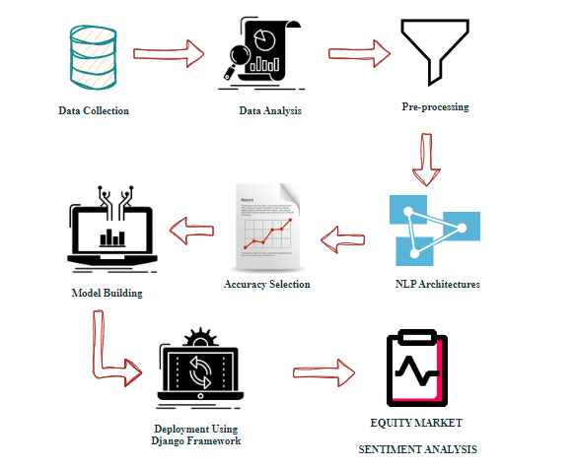
Architecture diagram

Slide 10
Algorithm
Multinomial NB Algorithm
Logistic Regression Algorithm
Random Forest Classifier Algorithm

Slide 11
Modules Split up
Data Pre-processing
Data Analysis of Visualization
MULTINOMIALNB ALGORITHM
LOGISTIC REGRESSION ALGORITHM
RANDOM FOREST CLASSIFIER ALGORITHM
Deployment Using DJANGO

Slide 12
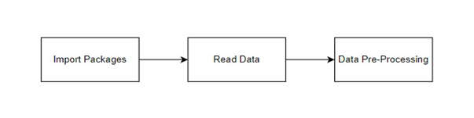
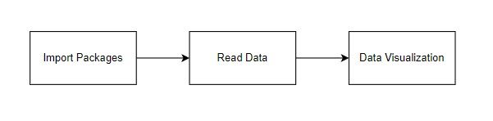
Modules Description
Data Preprocessing:
Data Analysis of Visualization:

Slide 13
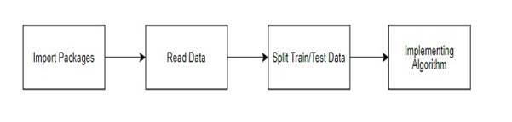
Algorithm Implementation
Multinomial Naïve Bayes Algorithm
- Multinomial Naive Bayes (MultinomialNB) is a probabilistic classification algorithm.
- Widely used in natural language processing tasks like text classification.
- Based on Bayes' theorem and assumes a multinomial distribution of features.
- Specifically used in document classification, where each feature represents term frequency.
- Calculates the probability of a document belonging to a class based on term frequency distribution.
- Simple yet effective, MultinomialNB is often successful in text classification tasks.

Slide 14
2. LOGISTIC REGRESSION ALGORITHM
- Logistic Regression is a statistical method for binary classification tasks.
- Predicts the probability of an event based on input features.
- Utilizes the logistic function to model the relationship between variables and binary outcomes.
- Widely used in machine learning due to interpretability and computational efficiency.
- Foundational algorithm for understanding the impact of input features on outcome likelihood.
3.RANDOM FOREST CLASSIFIER ALGORITHM
- Random Forest Classifier: Ensemble ML algorithm.
- Builds multiple decision trees during training.
- Outputs mode for classification or mean for regression.
- Effective in handling complex datasets.
- Mitigates overfitting and improves generalization.
- Widely used in finance, healthcare, and image recognition.

Slide 15
WORKFLOW DIAGRAM
Data Gathering
Data Pre-Processing
Choose model
Train model
Test model
Tune model
Prediction

Slide 16

OUTPUT

Slide 17
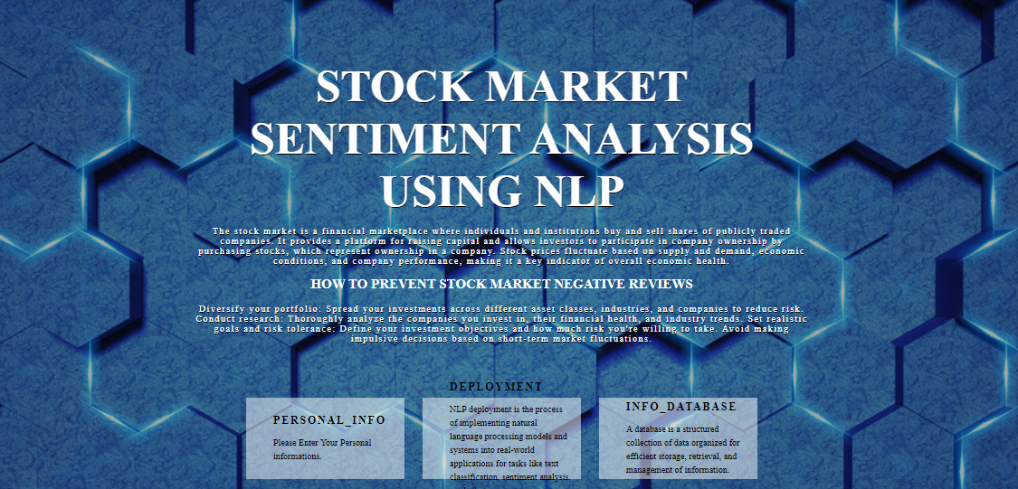
OUTPUT

Slide 18
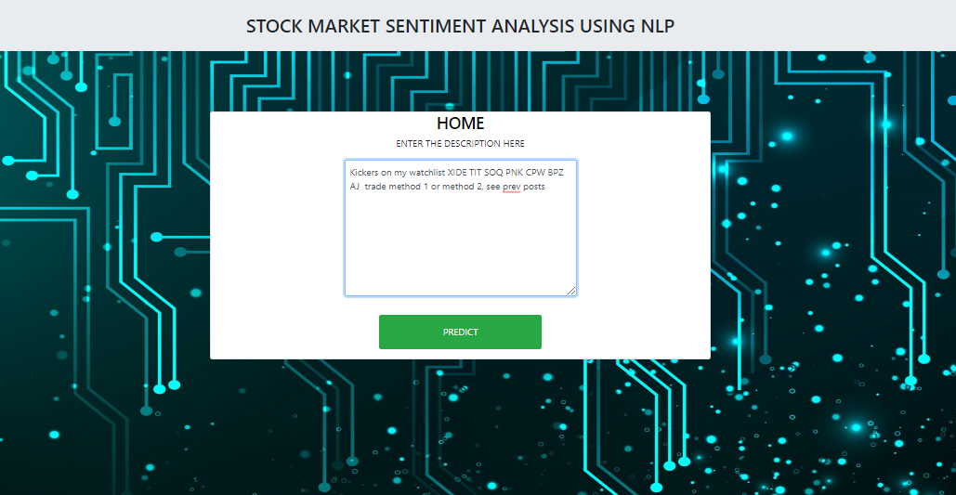
OUTPUT

Slide 19
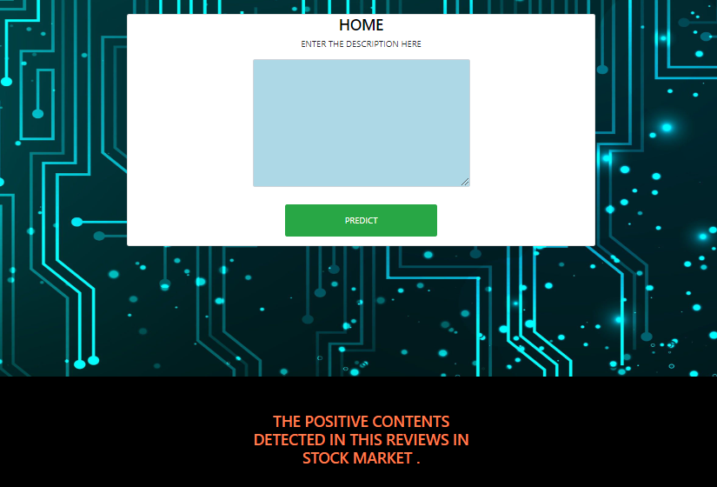
OUTPUT

Slide 20
Conclusion
Leveraging Natural Language Processing (NLP) techniques for equity market sentiment analysis provides invaluable insights into investor sentiments and market trends.
By extracting and analyzing textual data from news articles, social media, and financial reports, NLP enables a nuanced understanding of market sentiment, empowering investors to make more informed decisions.
This innovative approach not only enhances the efficiency of market analysis but also contributes to the development of predictive models that can adapt to dynamic market conditions.
Ultimately, the integration of NLP in equity market sentiment analysis holds significant potential for improving decision-making processes and maximizing investment outcomes.

Slide 21
References
[1] Predicting stock market using natural language processing (2023)
[2] Sentiment Analysis of Stocks Based on News Headlines Using NLP (2023)
[3] Using Financial News Sentiment for Stock Price Direction Prediction (2022)
[4] Combined deep learning classifiers for stock market prediction: integrating stock price and news sentiments (2021)
[5] Optimizing LSTM for time series prediction in Indian stock market (2020)
[6] A Prediction Approach for Stock Market Volatility Based on Time Series Data (2019)
[7] Predicting Closed Price Time Series Data Using ARIMA Model (2018)
[8] Predicting Stock Market Behavior using Data Mining Technique and News Sentiment Analysis (2017)
[9] Stock Trend Prediction using News Sentiment Analysis (2016)
[10] Stock Prediction Using Twitter Sentiment Analysis (2011)

Slide 22
THANK YOU

